Slide 1
Final Project: Data Comparison
BME 450A
Michael Teng

Slide 2
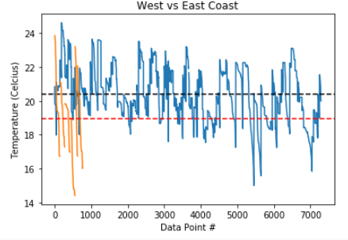
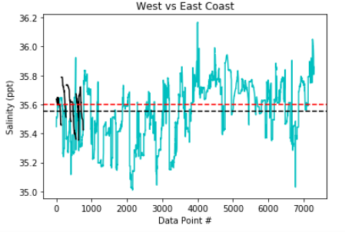
Temperature and salinity comparison from the East and West coasts of Australia
Coast | West Coast | East Coast
Temperature (°C) | 20.39 | 18.94
Salinity (ppt) | 35.56 | 35.6
Latitude | -33.99 | -32.0
Longitude | 151.45 | 115.4

Slide 3
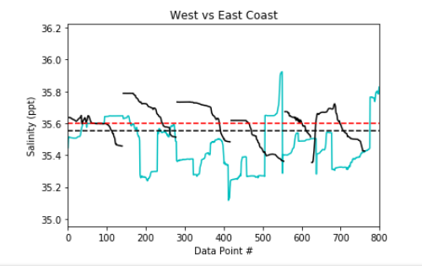
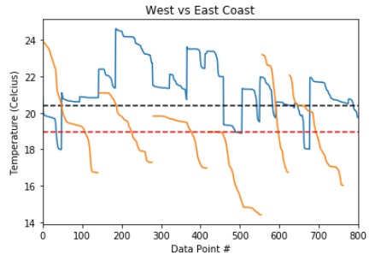
Comparison of Ocean Data from Australia

